Slide 1
Hera
A new Programming Language Using C++

Slide 2
Today’s Contents
Introduction to Hera Programming language
Basic Terminology
Data Structure point of view
Application
Why this programming language

Slide 3
Making a programming language is it easy or complex task?

Slide 4
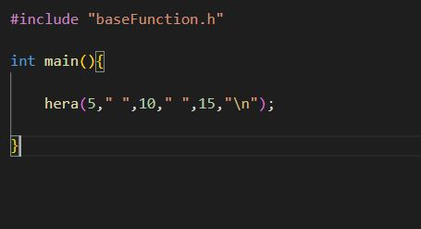
1. Brief Overview of Hera
Print function of some
programming language:
C -> printf()
C++ -> cout
Java -> println()
Hera -> hera()

Slide 5
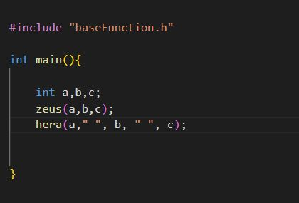

1. Brief Overview of Hera
Input function of some
programming language:
C -> scanf()
C++ -> cin
python -> input()
Hera -> zeus()

Slide 6
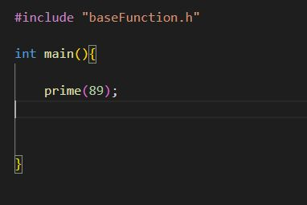
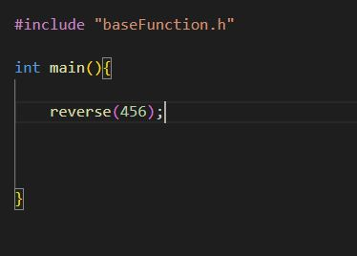
2. Basic Terminology
Prime or not?
Reverse a number

Slide 7
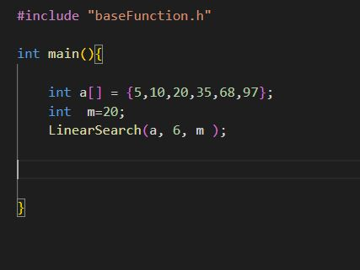
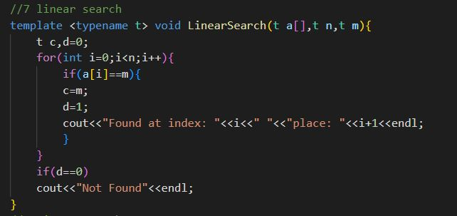
2. Basic Terminology
Linear Search
Linear Search backend using c++

Slide 8
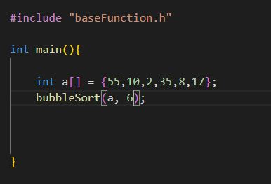
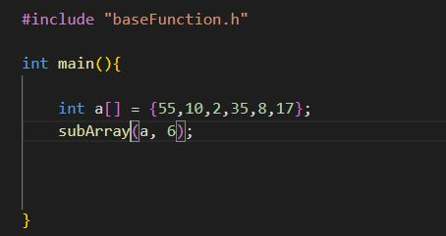
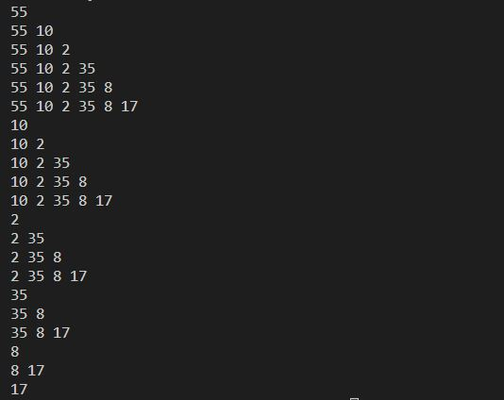
2. Basic Terminology
Bubble Sort
Possible Sub Array
Output of Possible sub Array

Slide 9
2. Basic Terminology
Tower of Hanoi
Fibonacci
Permutation
Remove Duplicates from Array
STL function

Slide 10
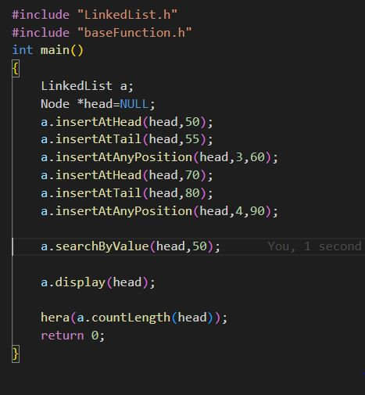
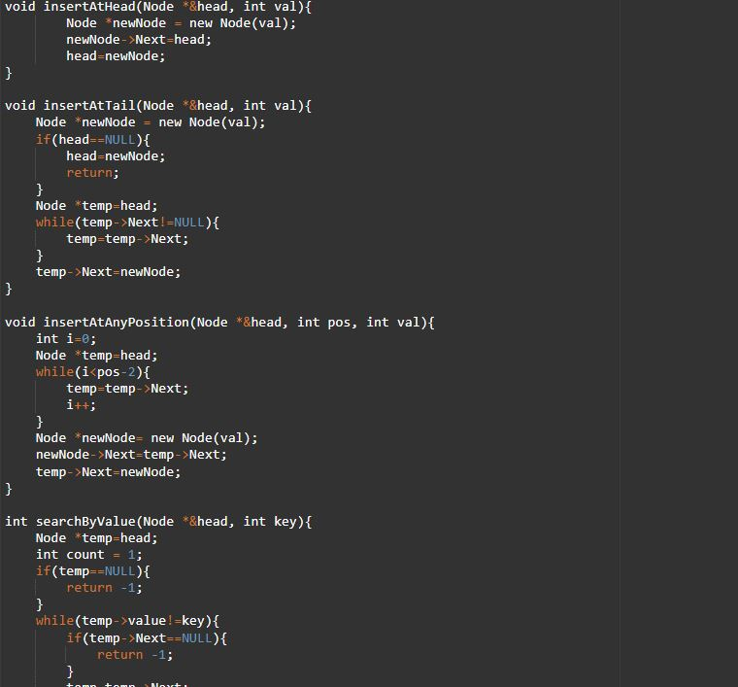
3. Data Structure Point of view
Linked List

Slide 11
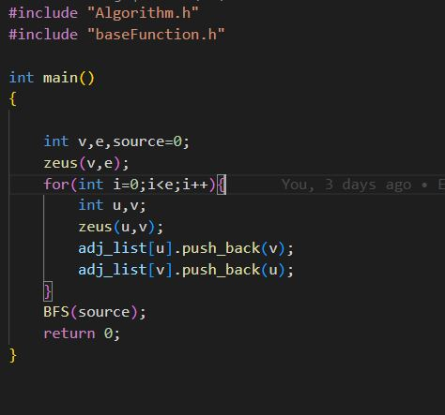
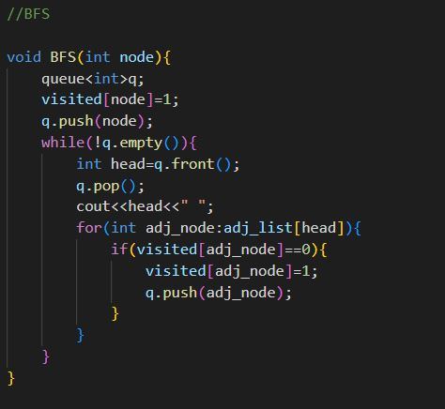
3. Data Structure Point of view
Breath First Search

Slide 12
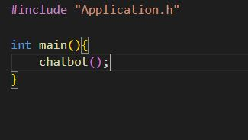
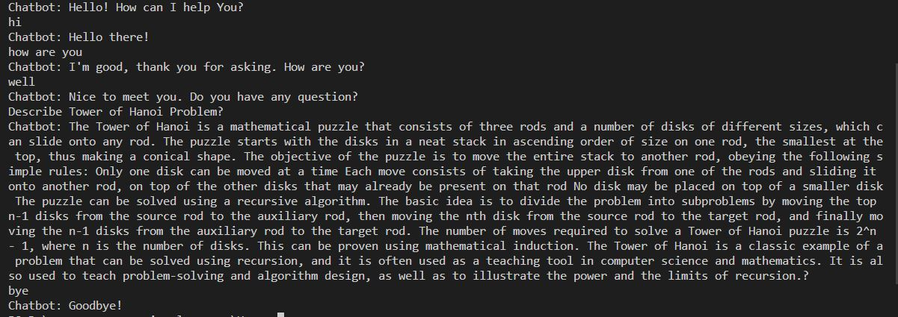
4. Application
Rule based Chabot project

Slide 13
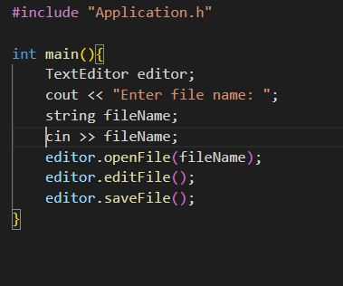
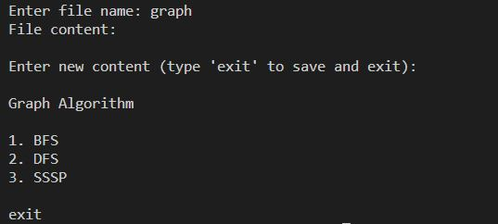
4. Application
Text Editor

Slide 14
5. Why this programming Language
It’s for non-CSE students and job holders
It’s easy to use
Human conversation type language.

Slide 15
Thank you

